Slide 1
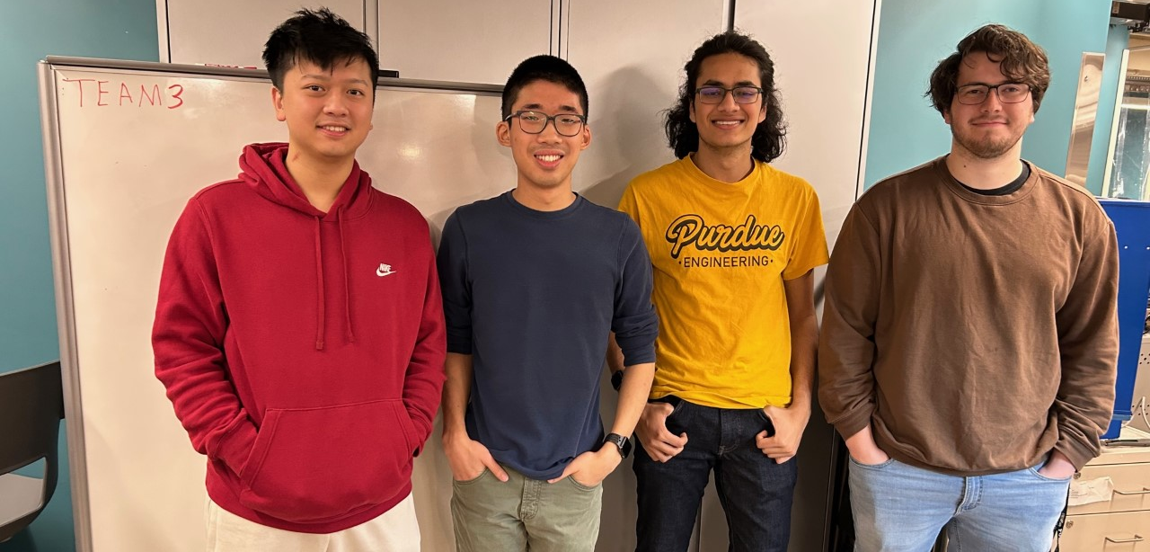

ECE 477 FINAL REVIEW: TEAM #3
<Add team picture and relevant project picture here>

Slide 2
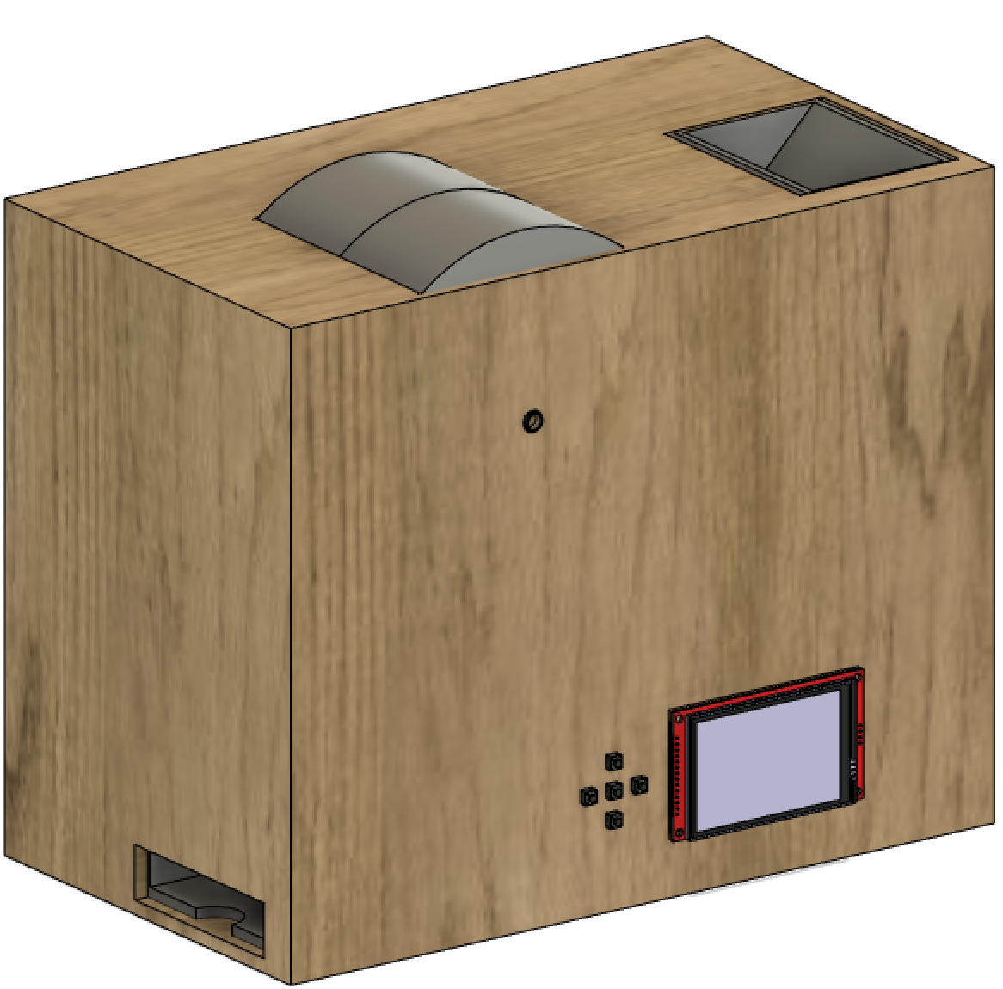
OUTLINE
Project Overview
Block Diagram
Design Challenges
Individual Contributions
Project Video Demonstration
Questions

Slide 3
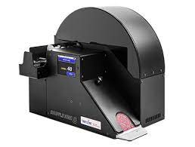
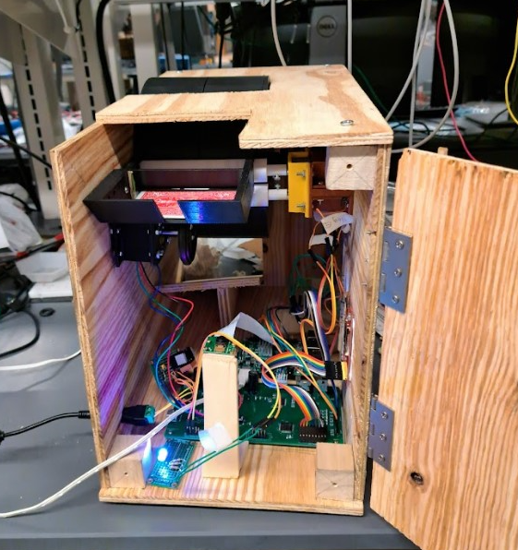
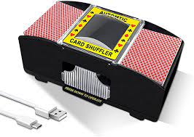
PROJECT OVERVIEW
Automatic Card Shuffler
Allows user to specify deck order or winner
Scans cards and inserts them in calculated order
Cards drop out onto deck in order
Uses computer vision to identify cards
Uses motors to place card in predetermined slot
UI through LCD and Button Inputs
Middleground cost-wise

Slide 4
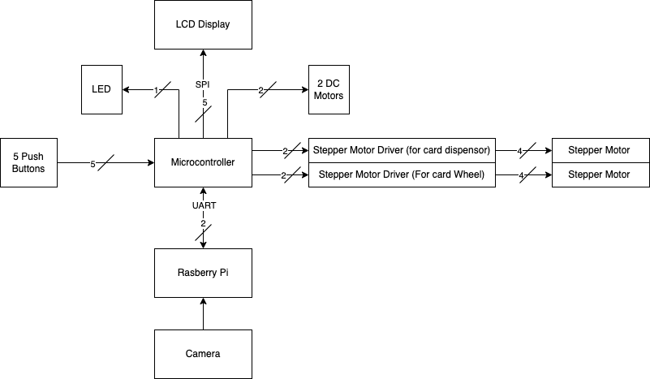
BLOCK DIAGRAM
Overall Electrical Schematic

Slide 5
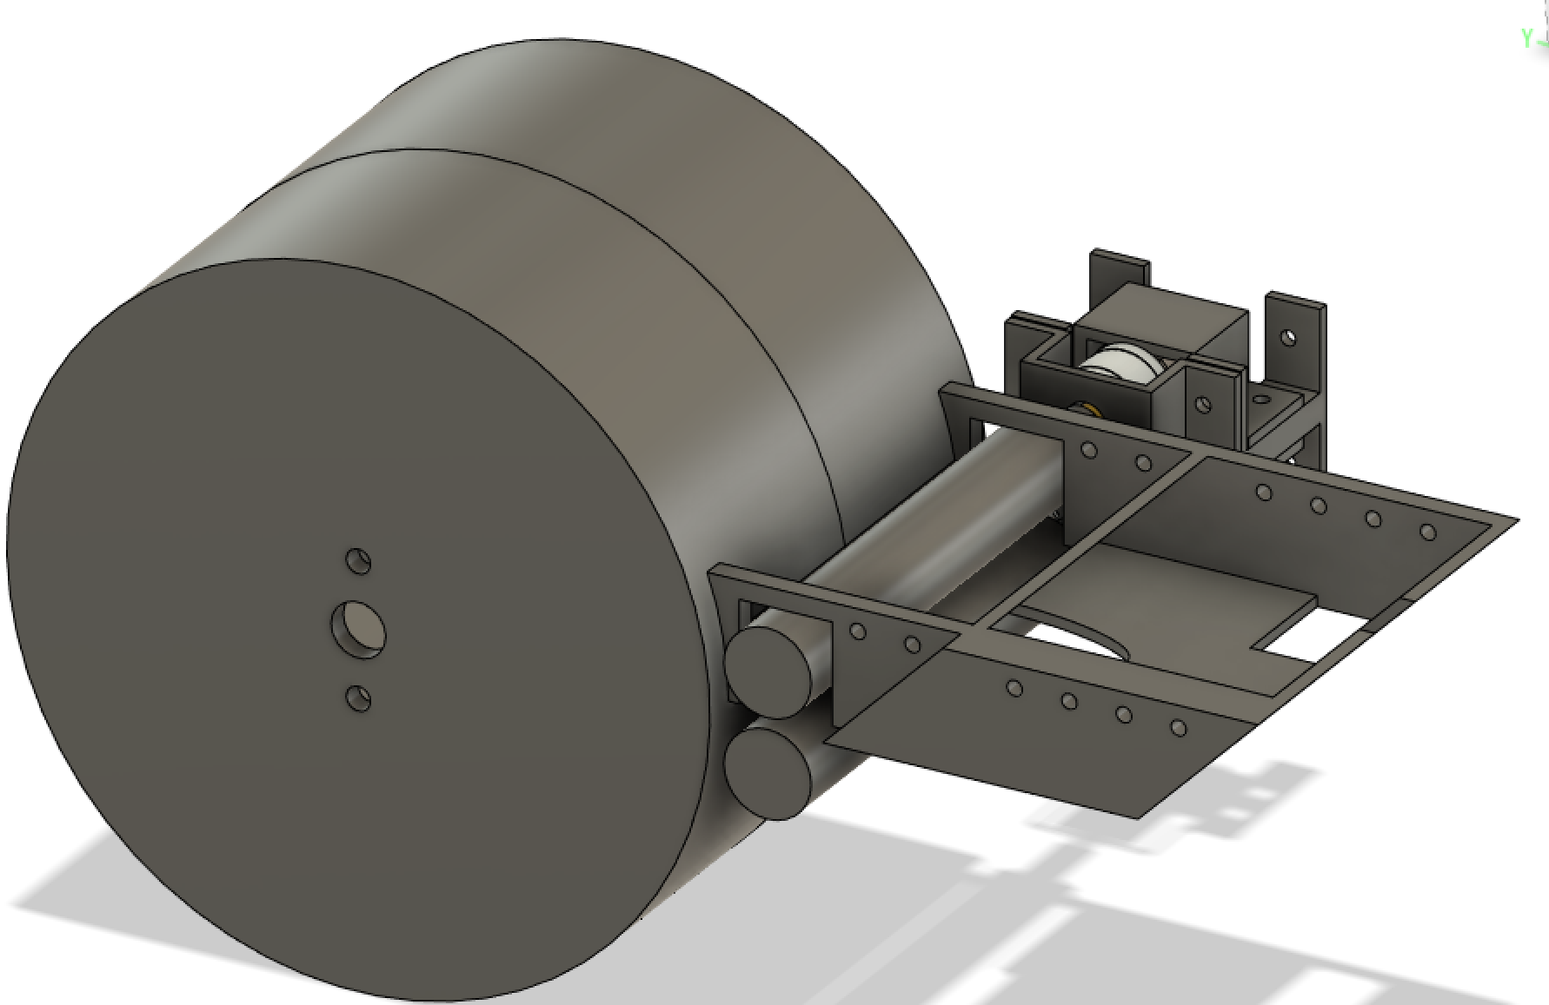
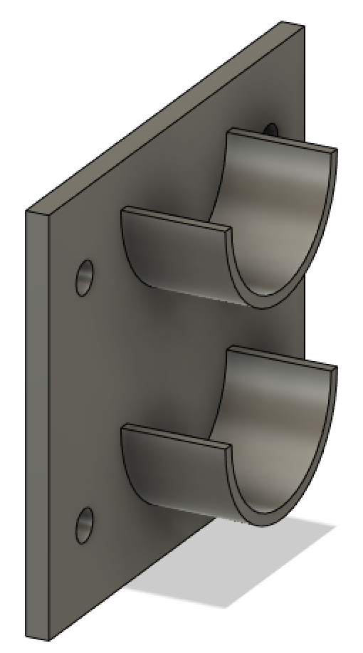
DESIGN CHALLENGES
Mechanical integration
Precise mounting
Stepper motor driver configuration

Slide 6
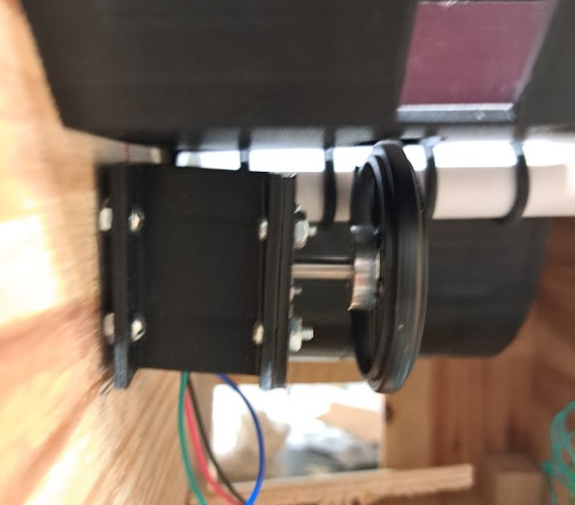
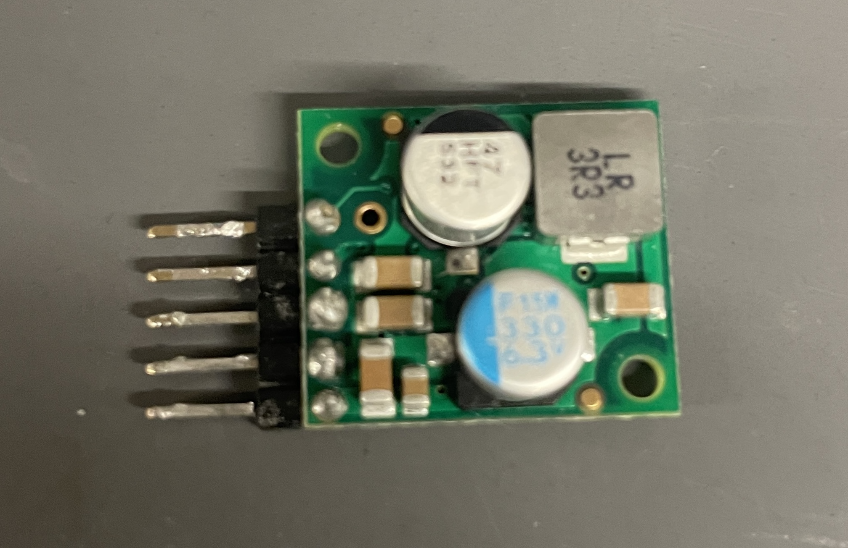
Design Challenges
Last minute component failure
Buck converter
Motor mount

Slide 7
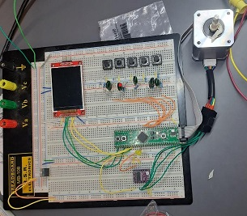
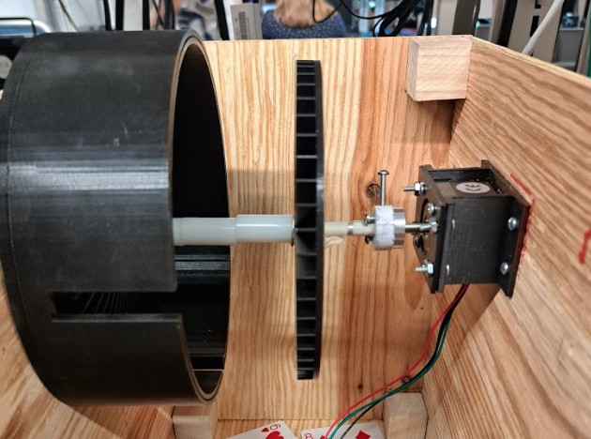
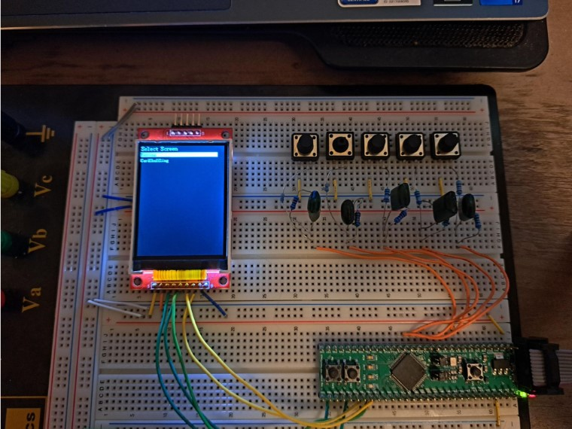
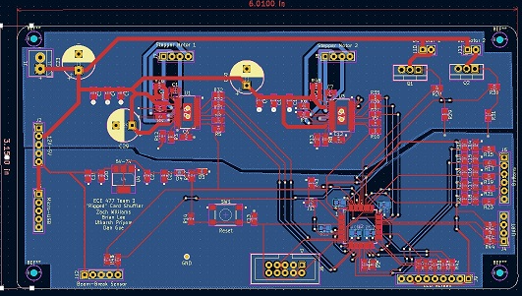
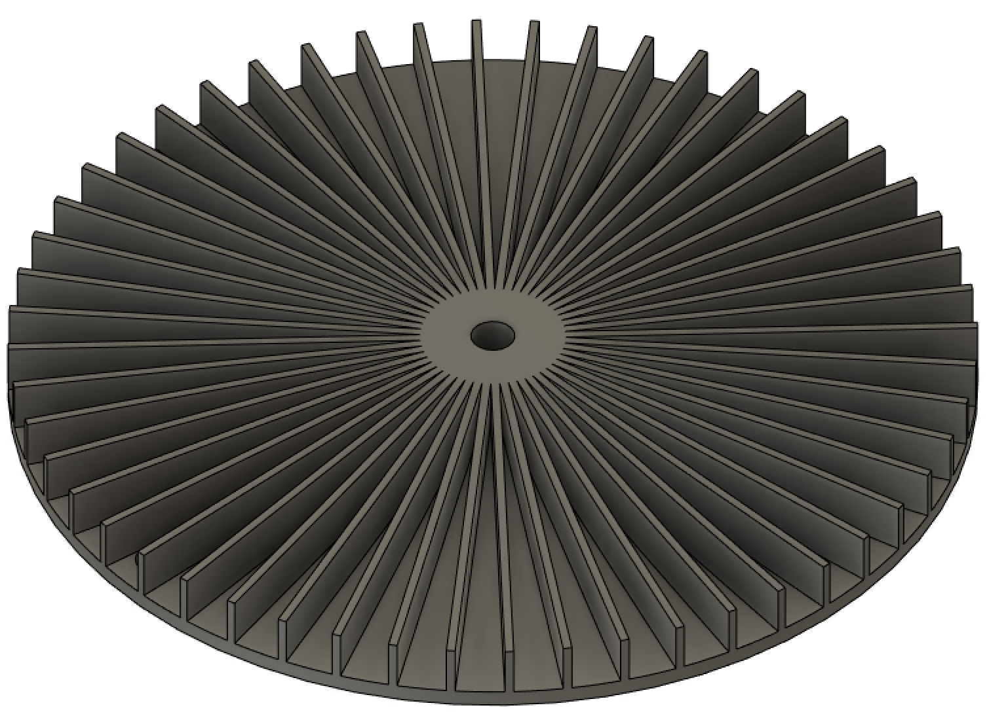
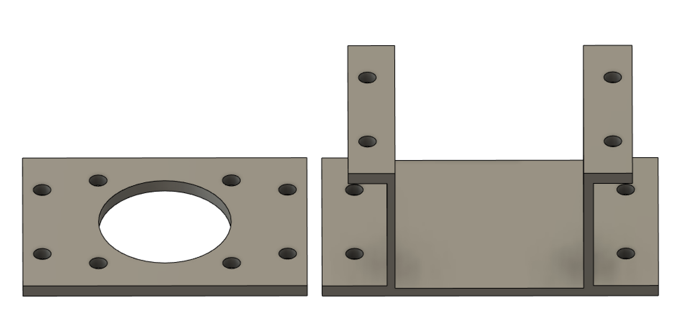
INDIVIDUAL CONTRIBUTIONS
Zach Williams

Slide 8
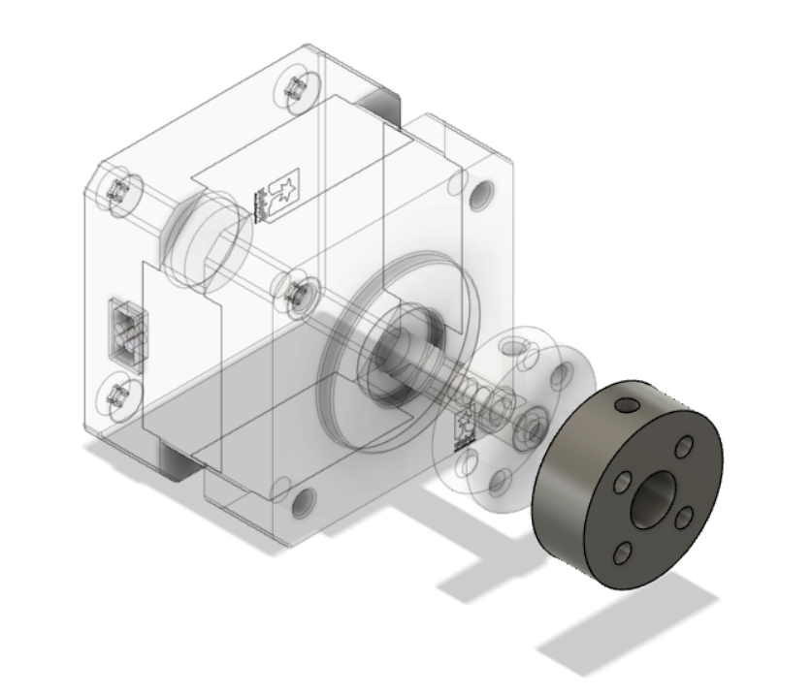
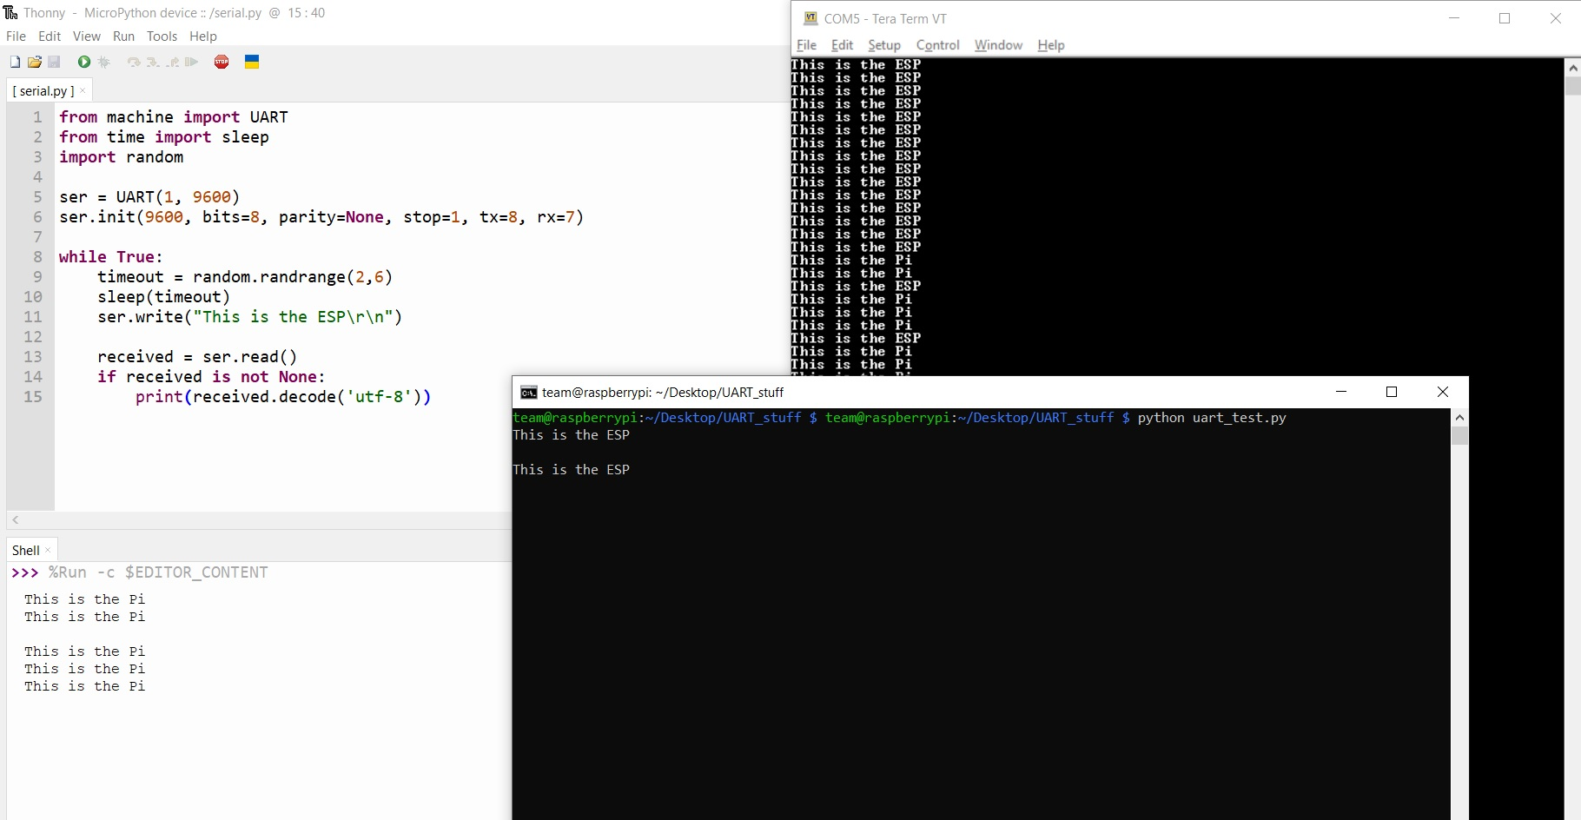
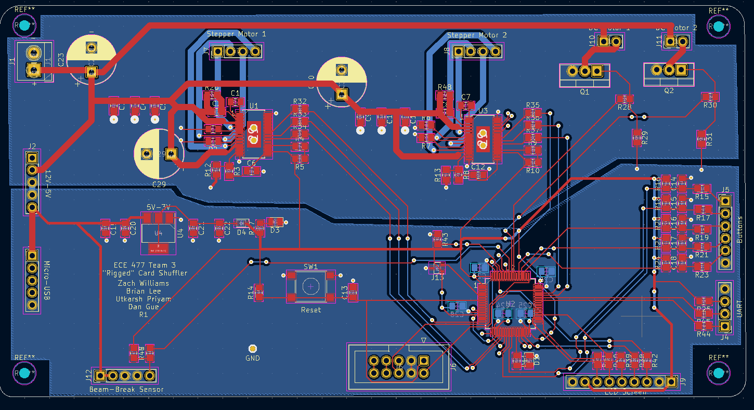

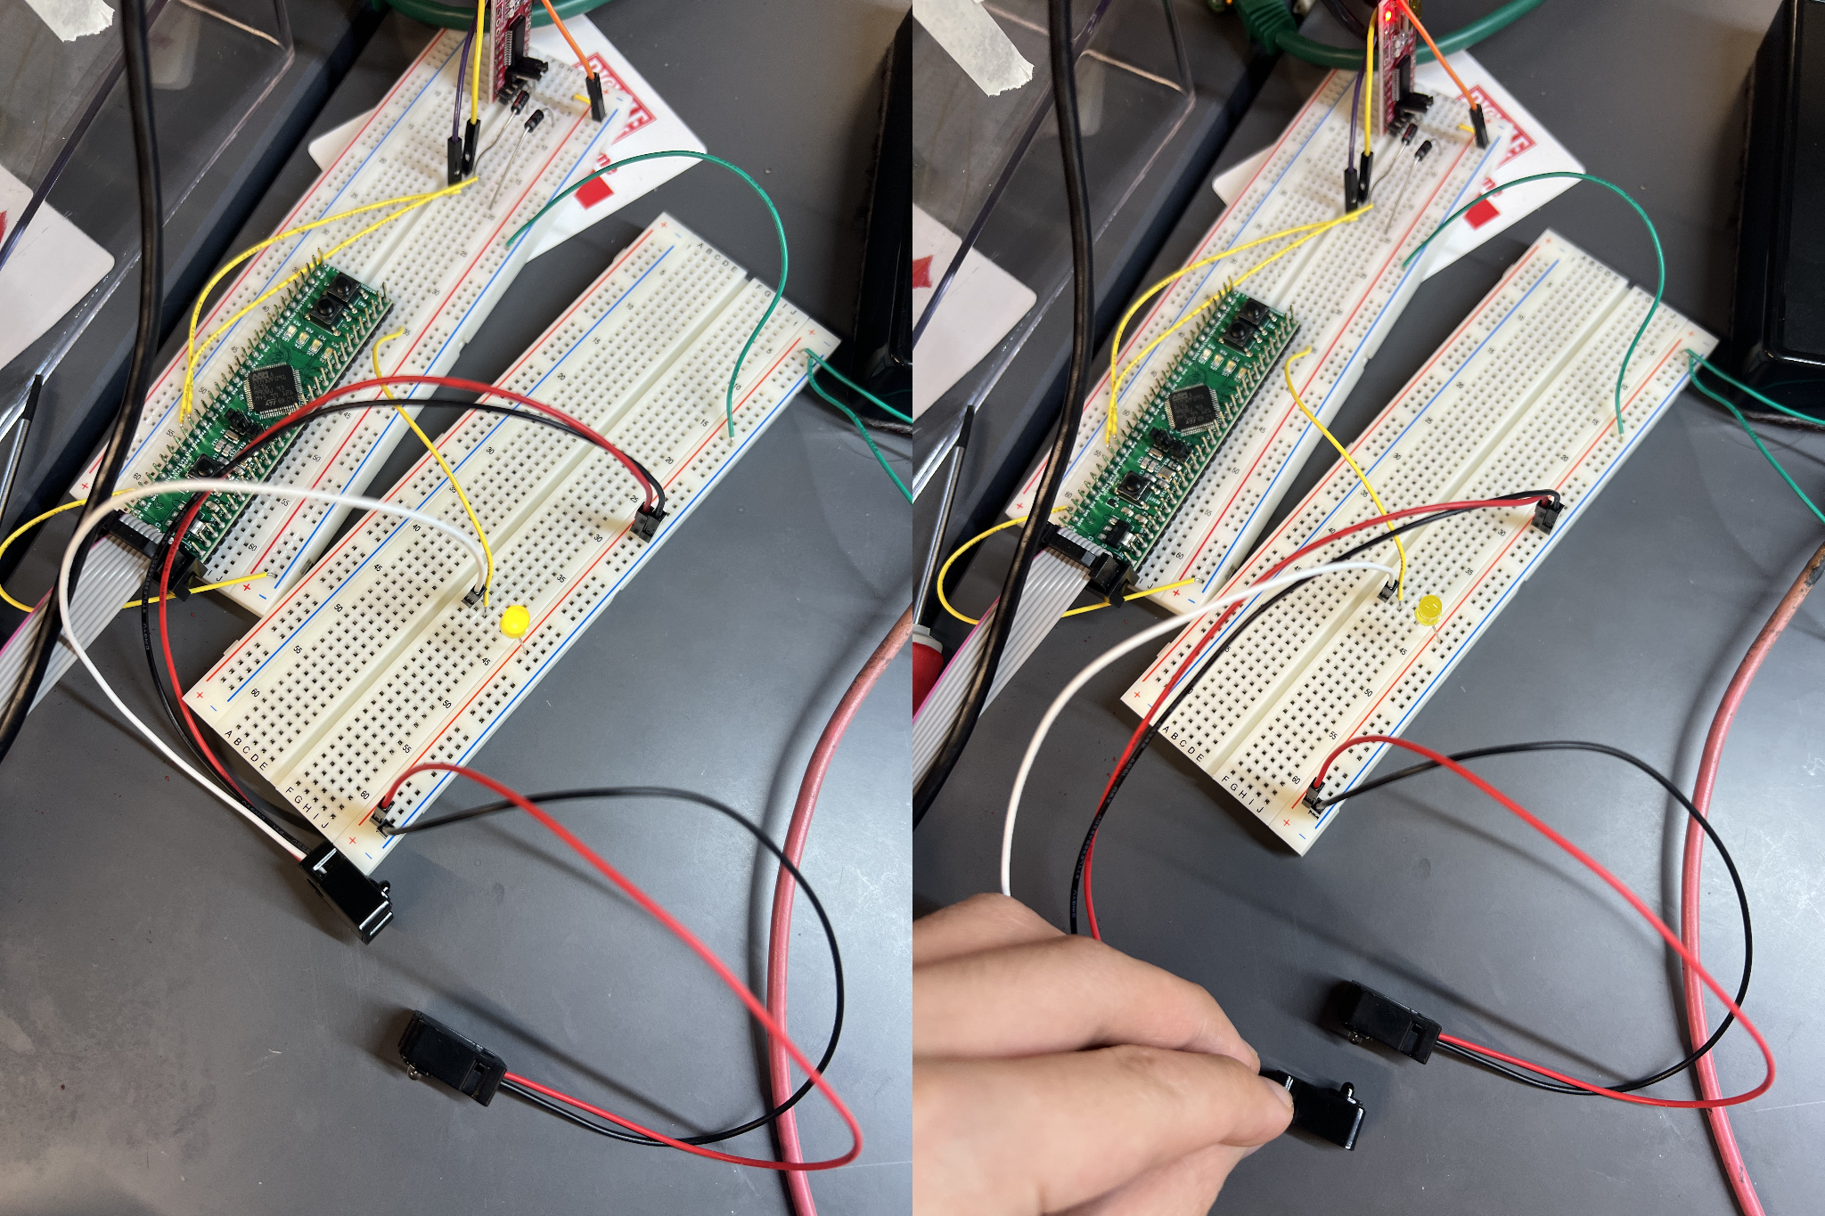
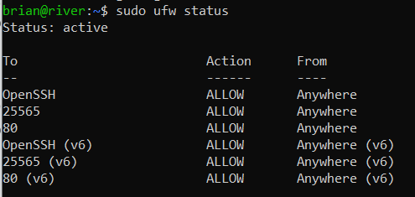
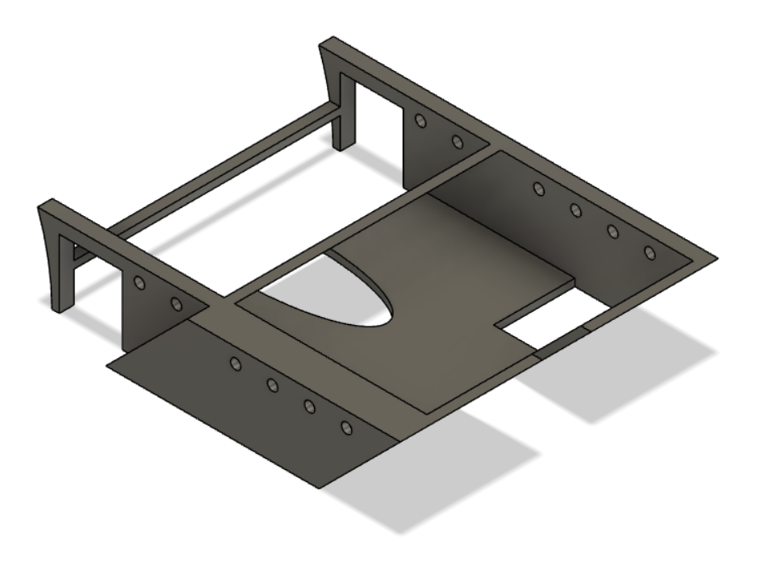
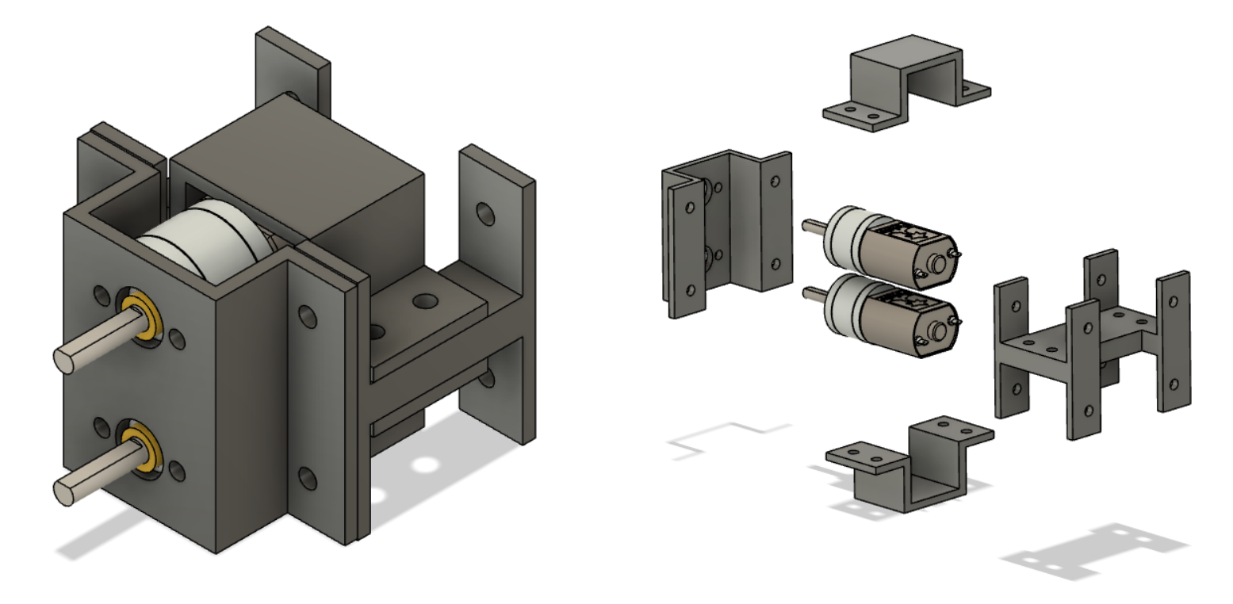
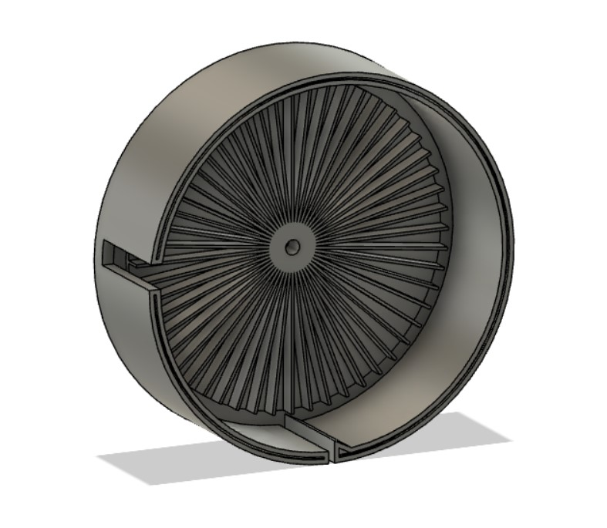
INDIVIDUAL CONTRIBUTIONS

Slide 9
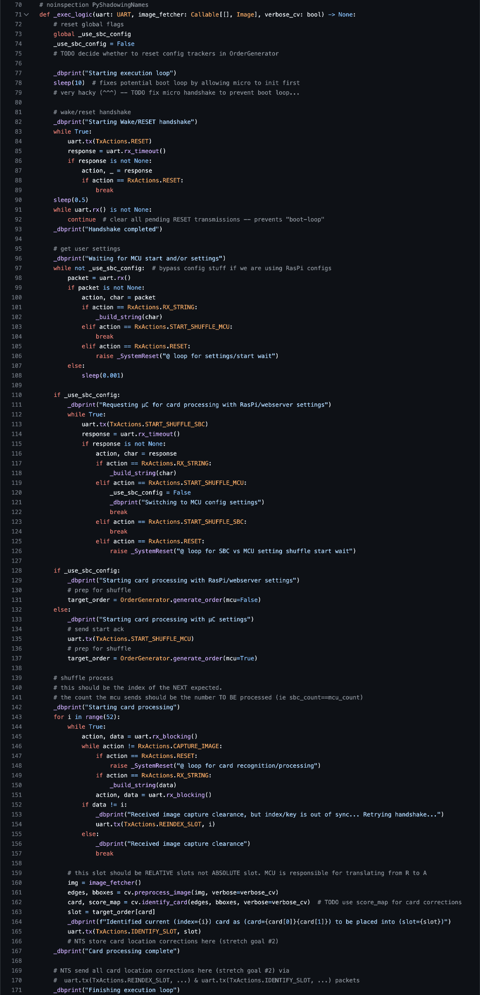
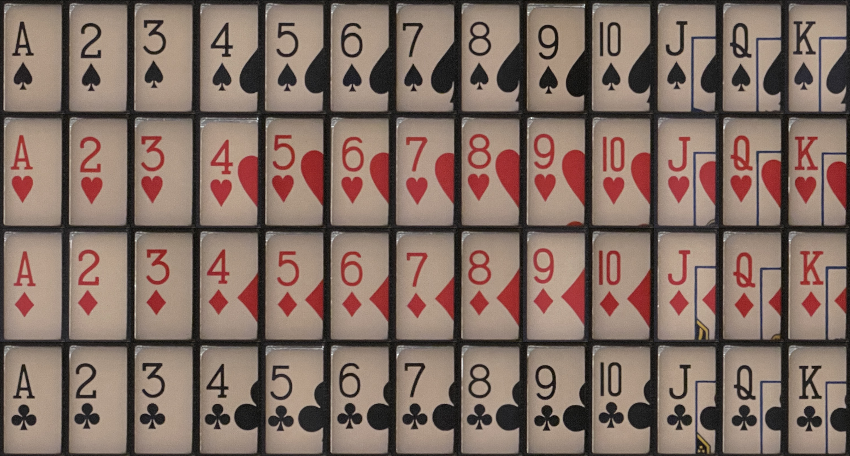
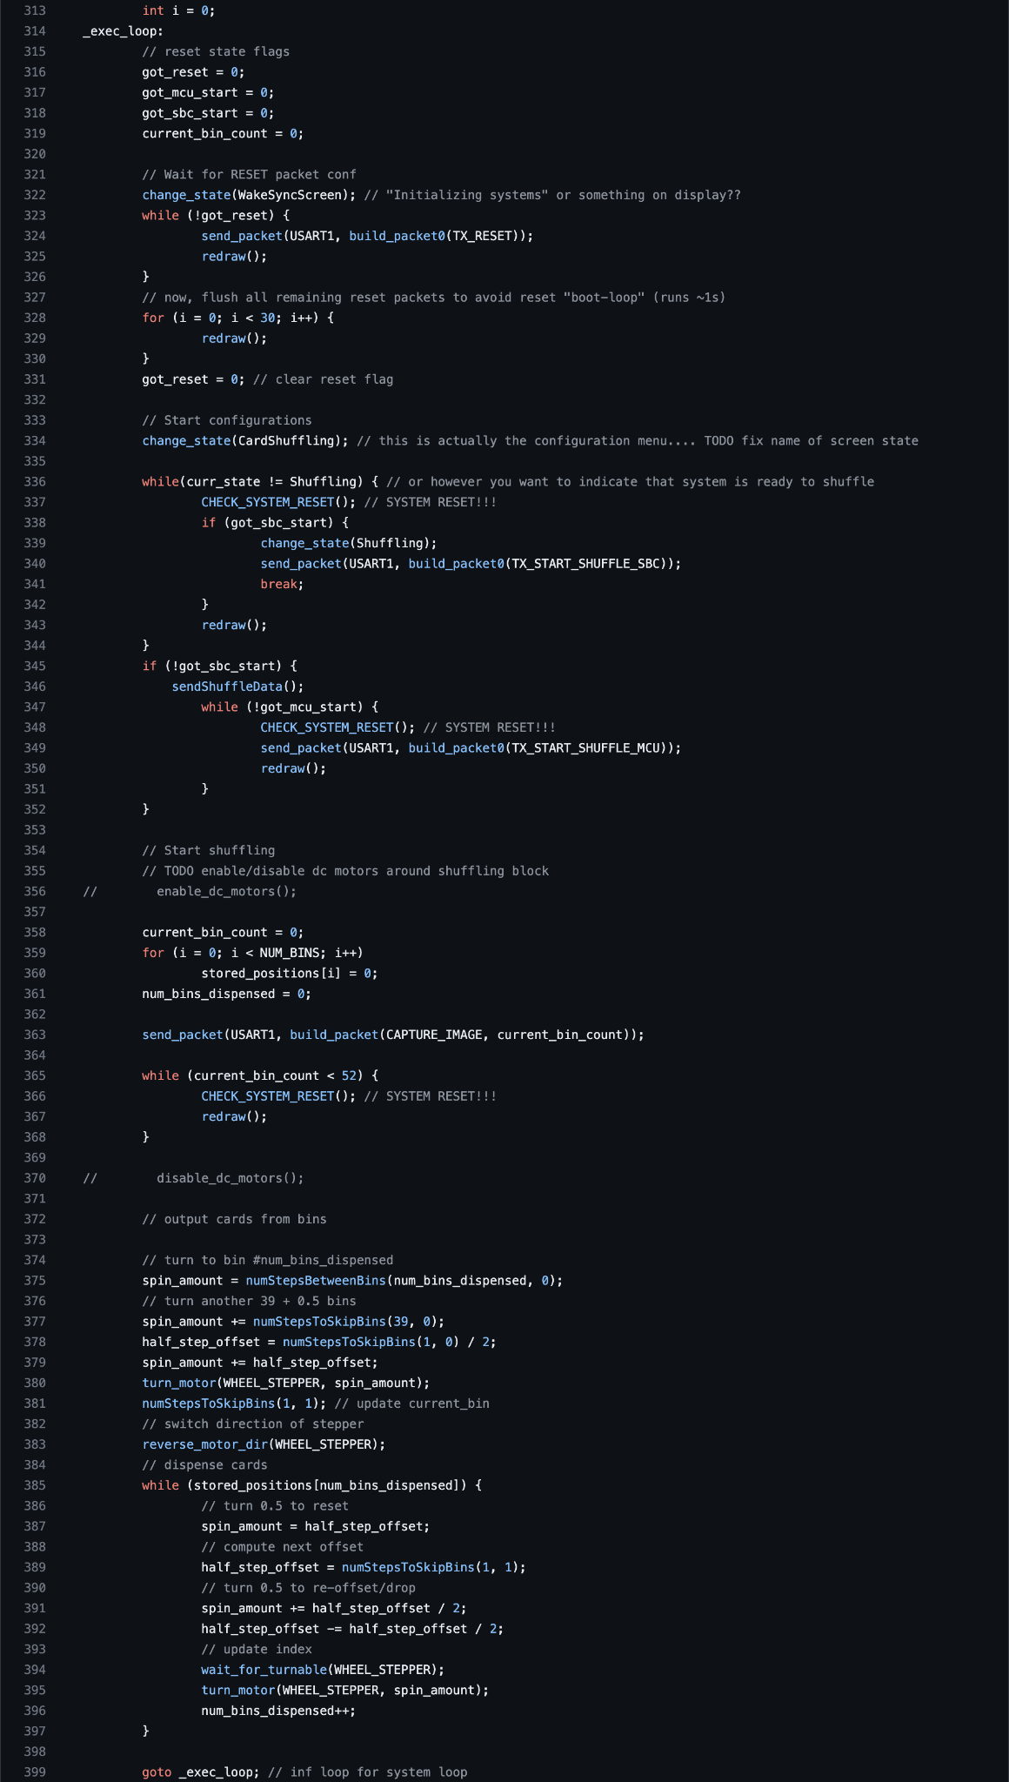
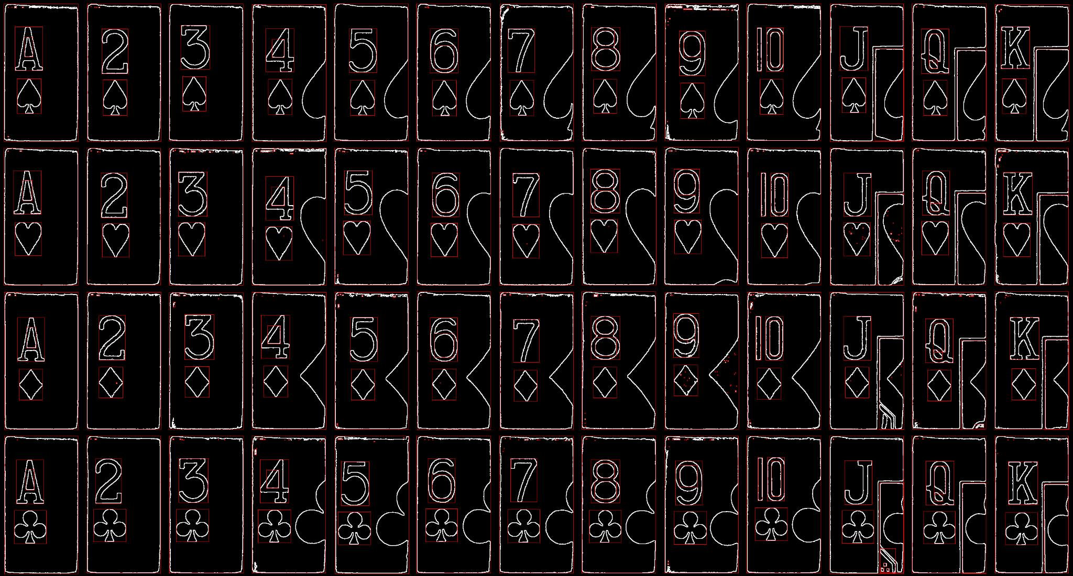
INDIVIDUAL CONTRIBUTIONS
Utkarsh Priyam

Slide 10
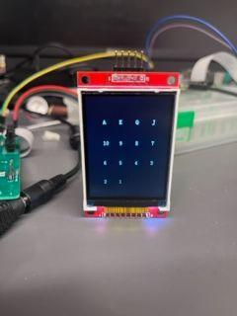
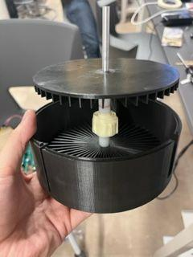
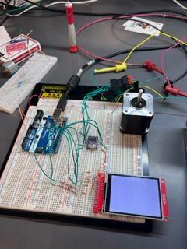
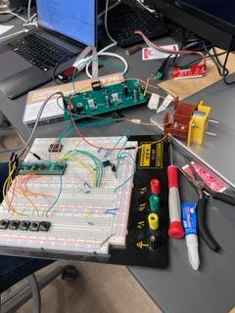
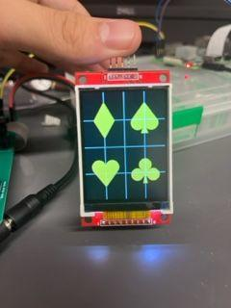
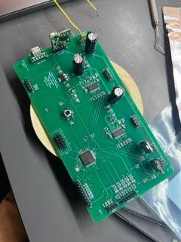
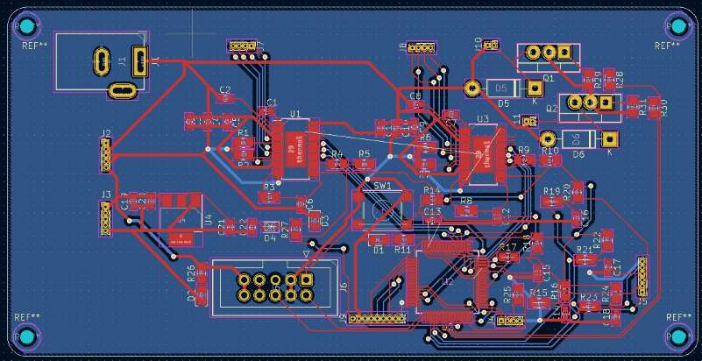
INDIVIDUAL CONTRIBUTIONS

Slide 11
PROJECT DEMONSTRATION
(Hardware): An ability for a microcontroller to operate multiple DC motors connected to a high-friction roller to consistently take only the bottom card off a deck with an error-free rate of at least 90%.
(Hardware): An ability for a microcontroller and the Raspberry Pi to communicate via a UART transmission line.
(Hardware): An ability for a microcontroller to control a stepper motor to precisely rotate the shuffling wheel.
(Hardware): An ability for a microcontroller to control an LCD screen via SPI to display device status and user inputs.
(Software): An ability for the Raspberry Pi to determine the rank and suit of individual cards with an accuracy of 75% or higher by taking a picture of it and processing the image.
Stretch Goals
(Software): An ability to host a web server on the Raspberry Pi that, when connected to via WiFi, provides a web interface for the user to input desired settings and control the device.
(Software): An ability to recognize when a previous image recognition was performed incorrectly and error correct by altering the output order accordingly.
(Software): An ability to perform generalized card recognition, i.e. recognize cards other than standard size print Bicycle playing cards.

Slide 12

PROJECT DEMONSTRATION

Slide 13
Questions?

